Slide 1
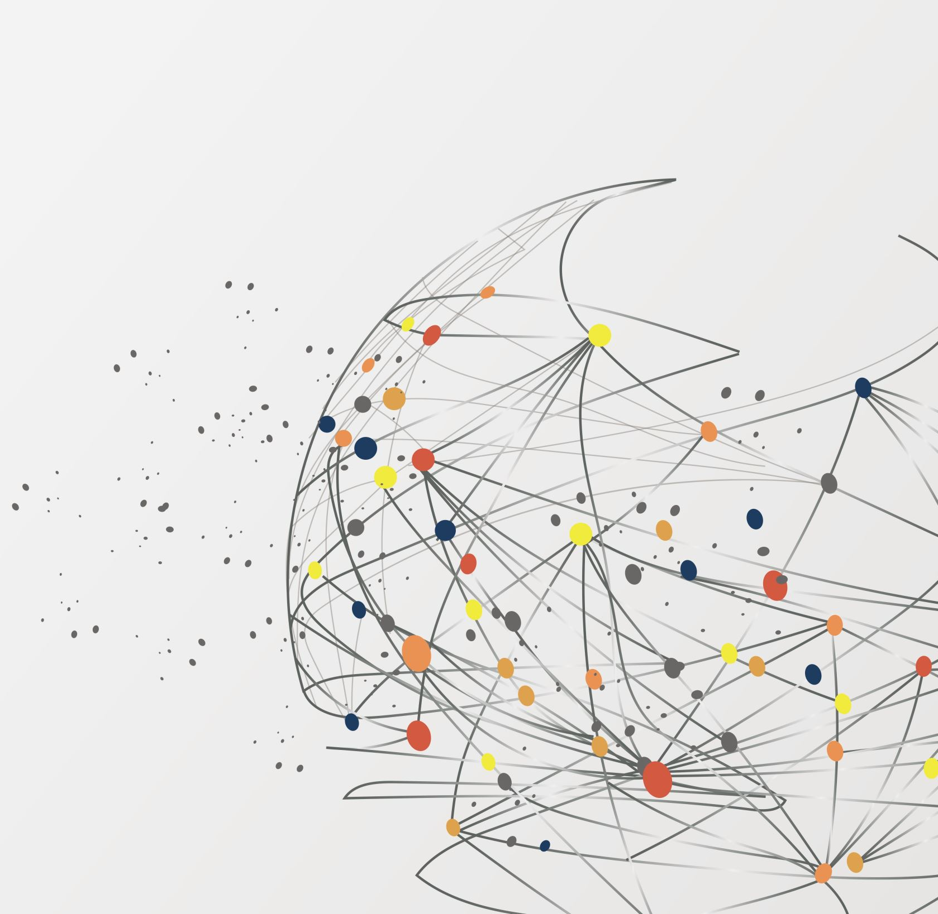
Wine variety Prediction
Machine Learning 1
CS 5805
-Taeesh Azal Assadi
taeeshazalassadi@vt.edu

Slide 2
CONTENT
Problem Statement
Phase 1 - Feature Engineering & EDA
Phase 2 - Regression Analysis
Phase 3 – Classification Analysis
Phase 4- Clustering and Association
REFERENCES

Slide 3
PROBLEM STATEMENT
The primary objective of this project is to develop a predictive model that can accurately determine the variety of wine based on descriptive tasting notes gathered from blind tastings. This model aims to bring a quantitative and analytical approach to wine identification, which could assist sommeliers, wine enthusiasts, and even novices in understanding the subtle nuances that differentiate various wine varieties.
Kaggle link-https://www.kaggle.com/datasets/zynicide/wine-reviews
130k + observations
10 total attributes –
2 numerical and 8 categorical features
Target class – variety
Important features – price, point, description, province

Slide 4
Phase I - Feature Engineering & EDA
Data preprocessing –
For Data preprocessing we removed NaN values which existed in features such as price, point , description, variety , etc
Insignificant and redundant feature such as country, twitter_handle and other insignificant features were dropped
Observations were checked for duplicacy and duplicate entries were dropped.
Aggregation or down-sampling was not performed, as the dataset contains discrete data detailing individual wines, where maintaining the uniqueness of each entry is crucial. Likewise, normalization or standardization techniques were not applied, as the dataset consists of absolute values that should remain unaltered to preserve the integrity of the data. The dataset is currently in a format that is directly applicable for machine learning algorithms without the need for transformation that could distort its originality.

Slide 5
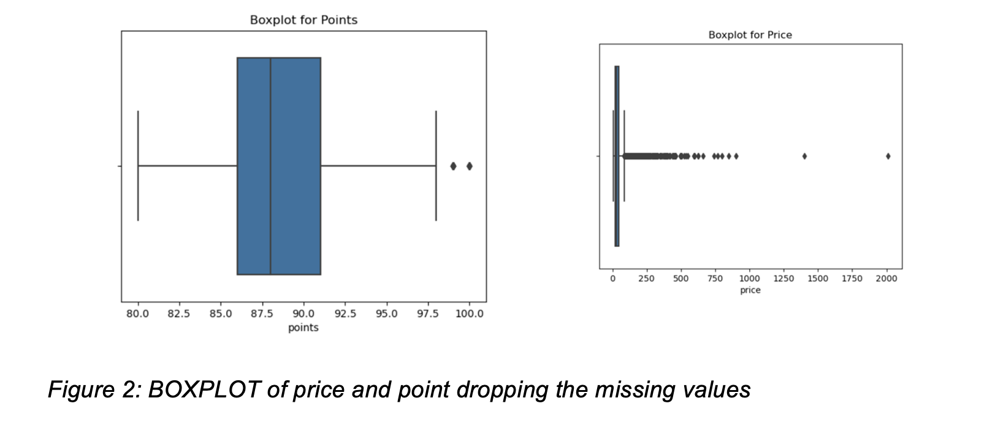
Phase I - Feature Engineering & EDA contd.....
Anomaly detection/Outlier Analysis was performed on the numerical data and outliers were removed

Slide 6
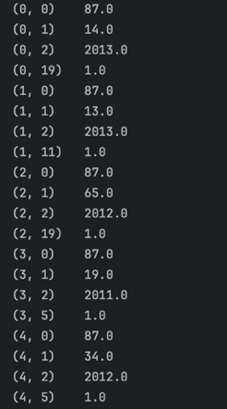
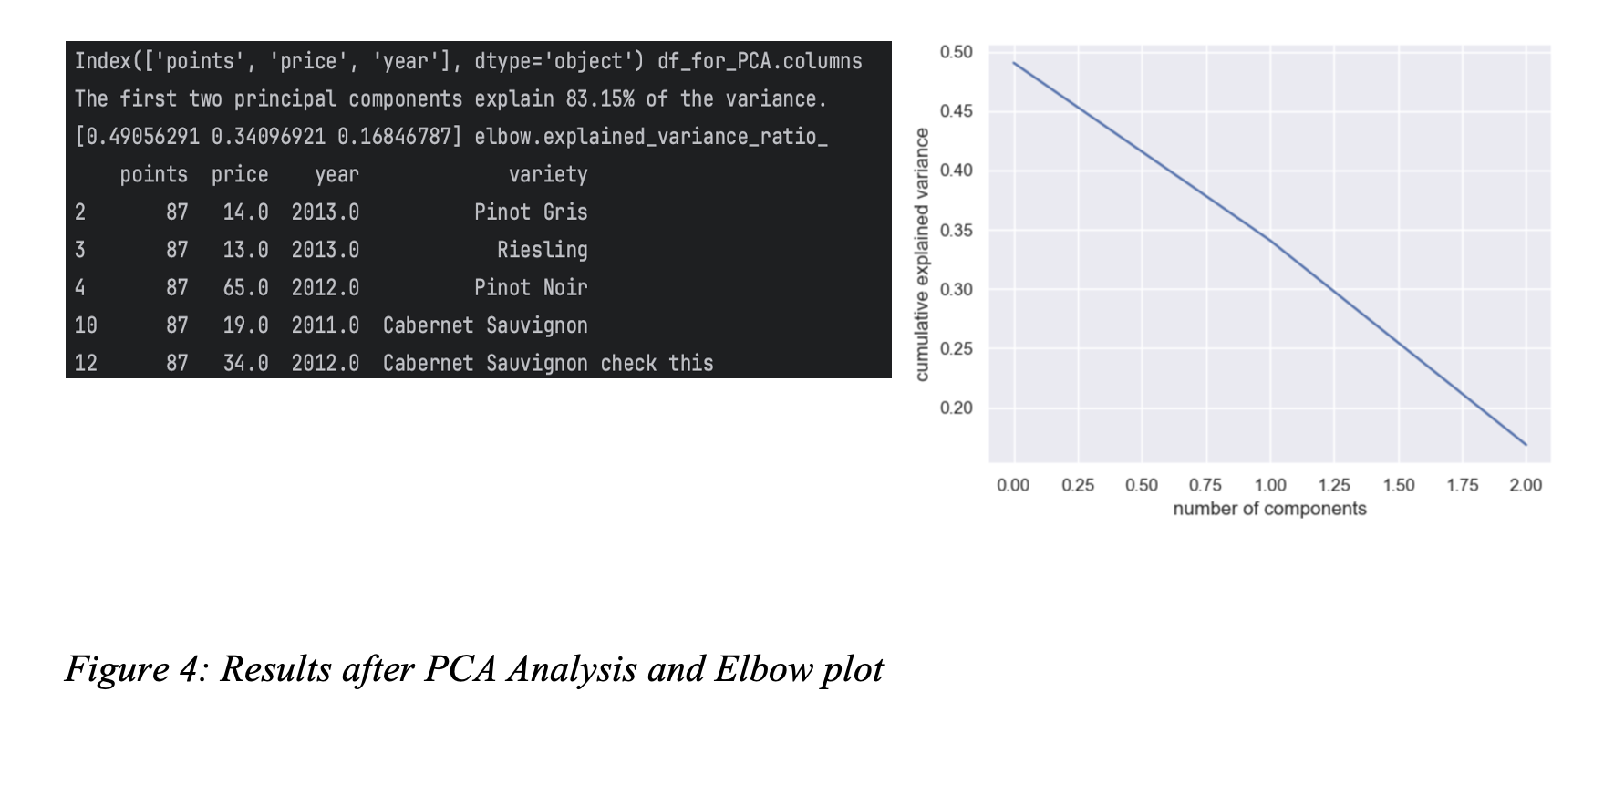
Phase I - Feature Engineering & EDA contd.....
• Text vectorization on the wine descriptions was performed. This process converts the textual content into numerical data, enabling quantitative analysis and model training.
After this PCA was done

Slide 7
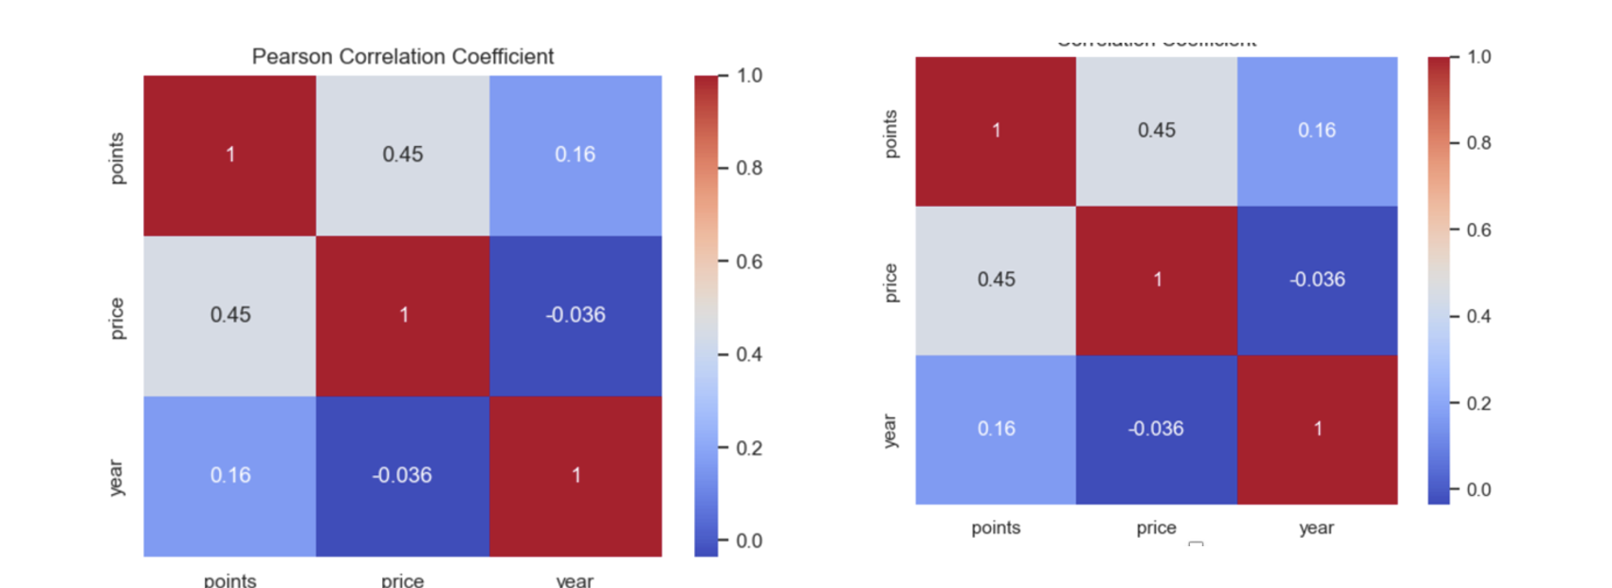
Phase I - Feature Engineering & EDA contd.....
HEATMAP OF COVARIANCE MATRIX

Slide 8
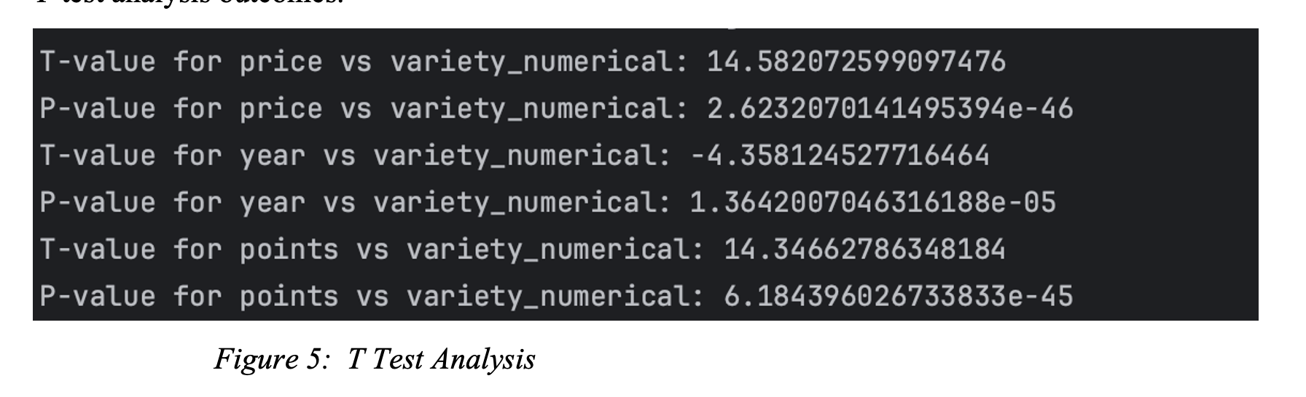
Phase II – Regression Analysis
T TEST

Slide 9
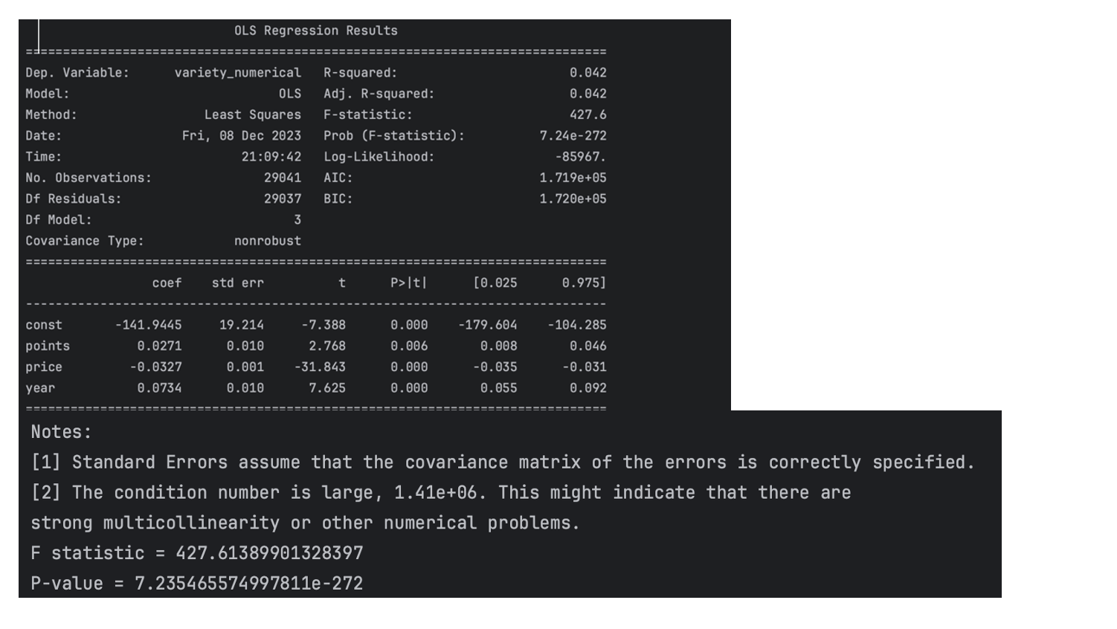
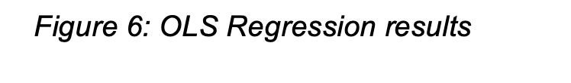
Phase II – Regression Analysis Contd..
OLS REGRESSION ANALYSIS

Slide 10
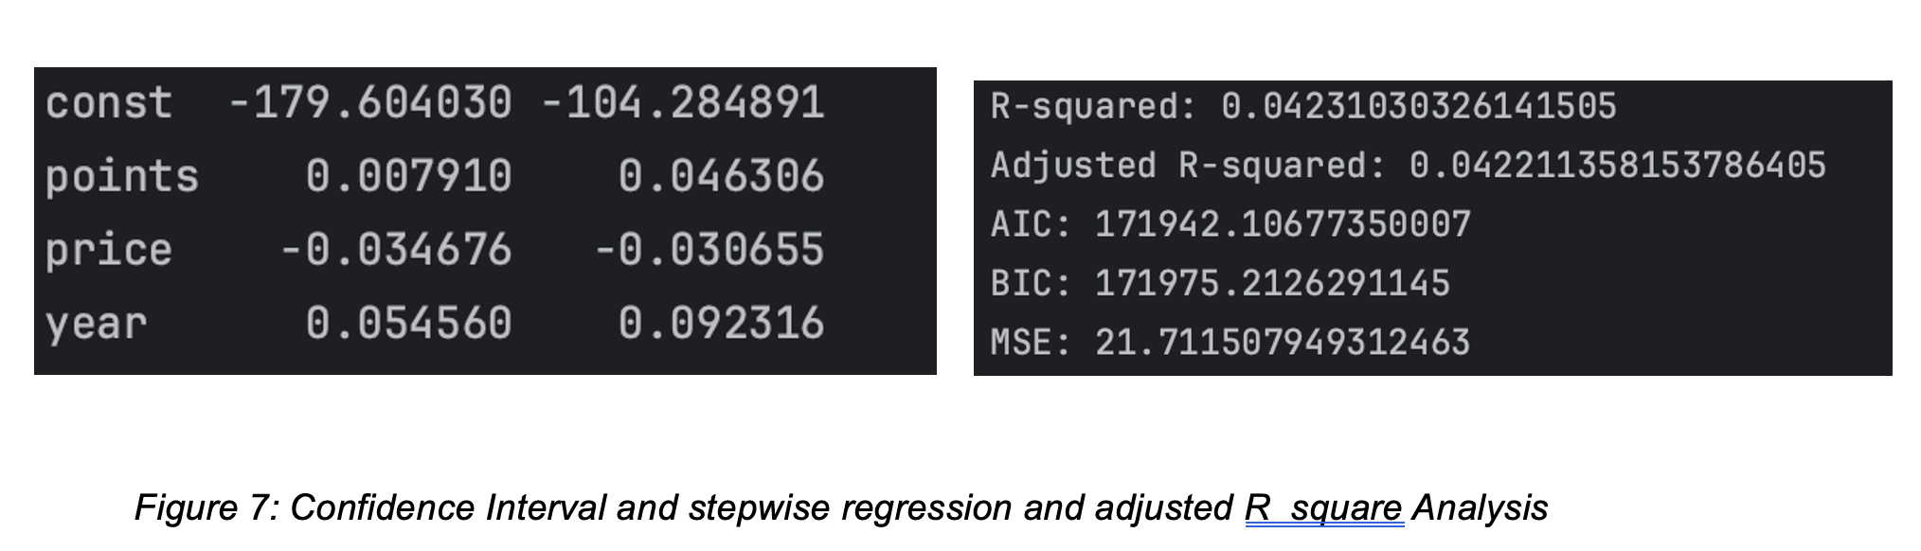
Phase II – Regression Analysis Contd..
Confidence Interval Analysis, stepwise regression and Adjusted R square Analysis

Slide 11
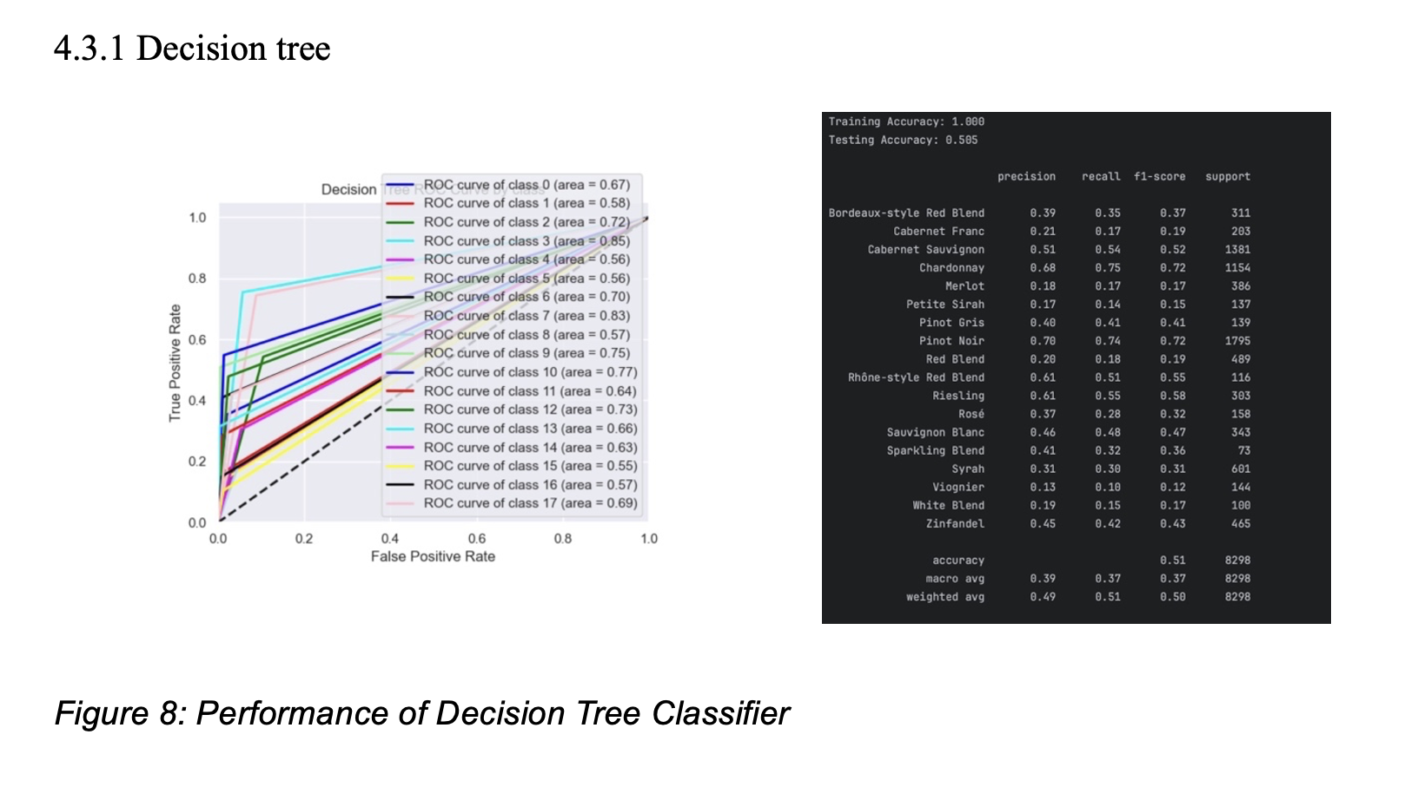
Phase III – Classification Analysis

Slide 12
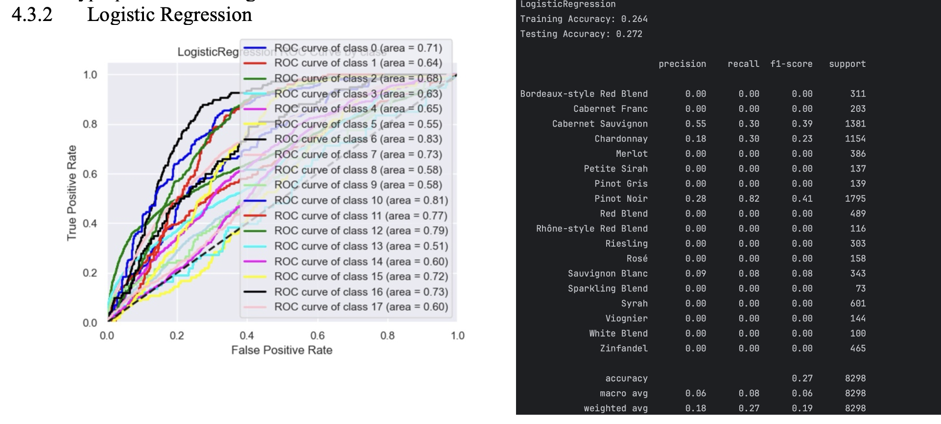
Phase III – Classification Analysis contd…

Slide 13
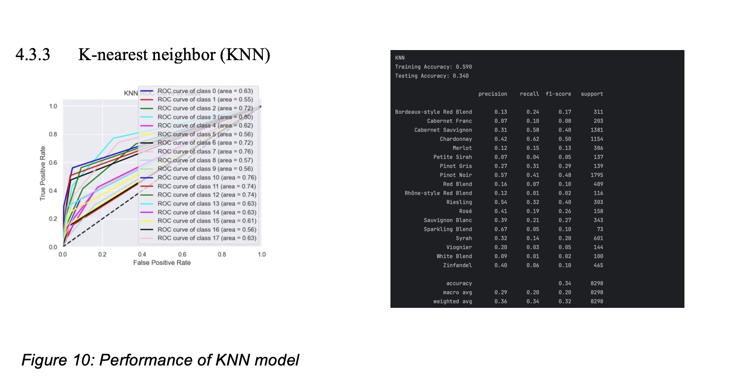
Phase III – Classification Analysis contd…

Slide 14
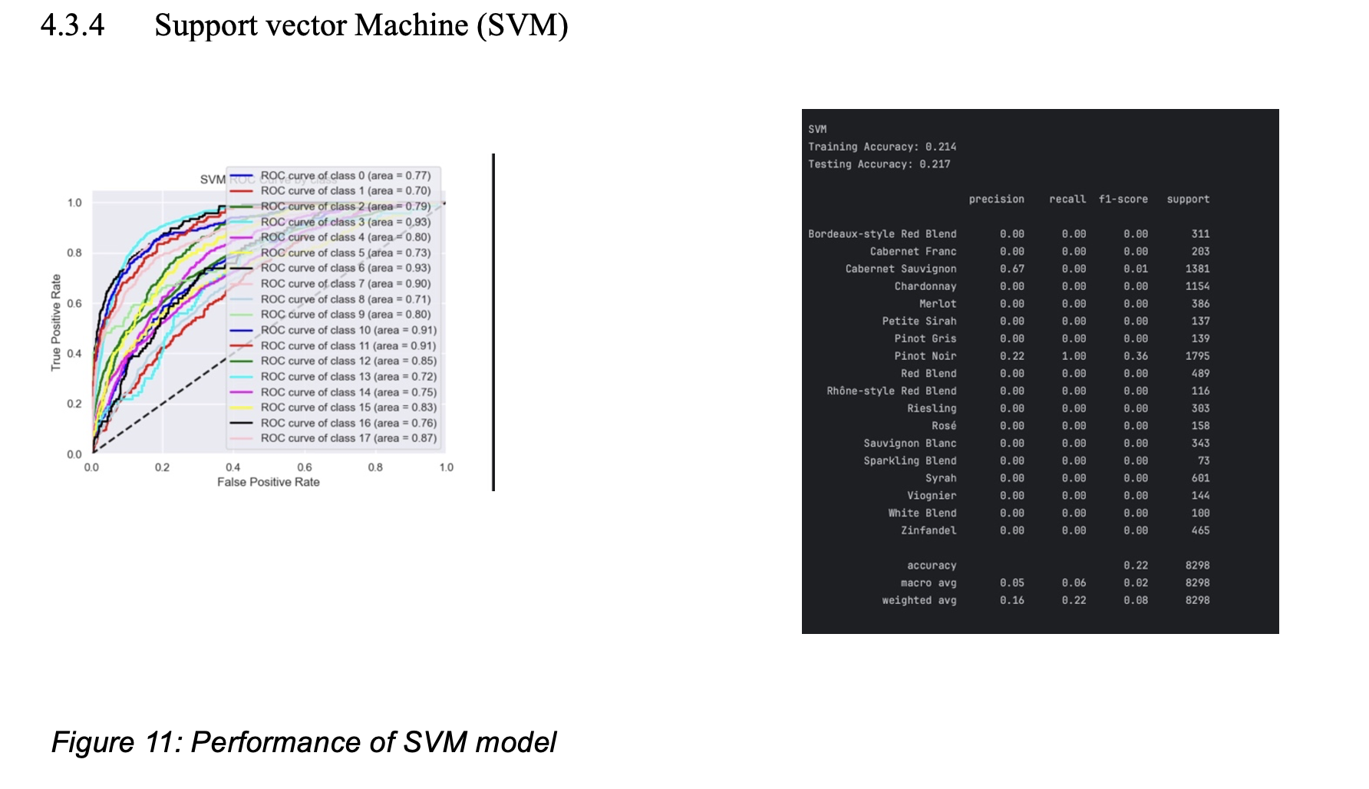
Phase III – Classification Analysis contd…

Slide 15
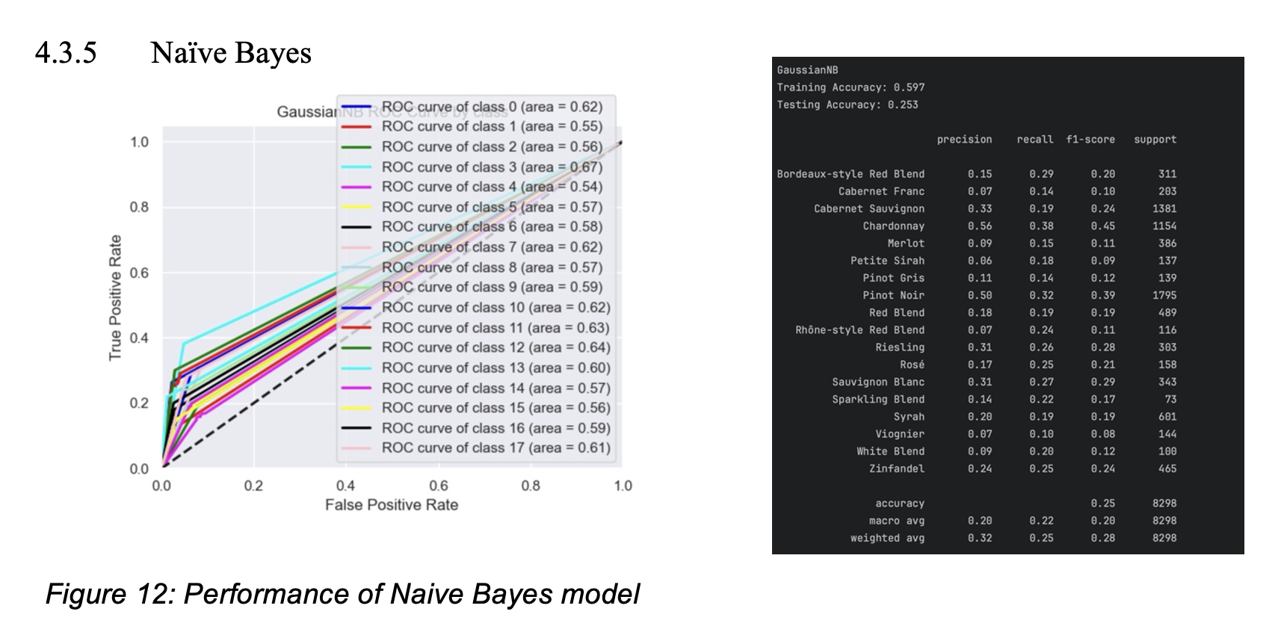
Phase III – Classification Analysis contd…

Slide 16
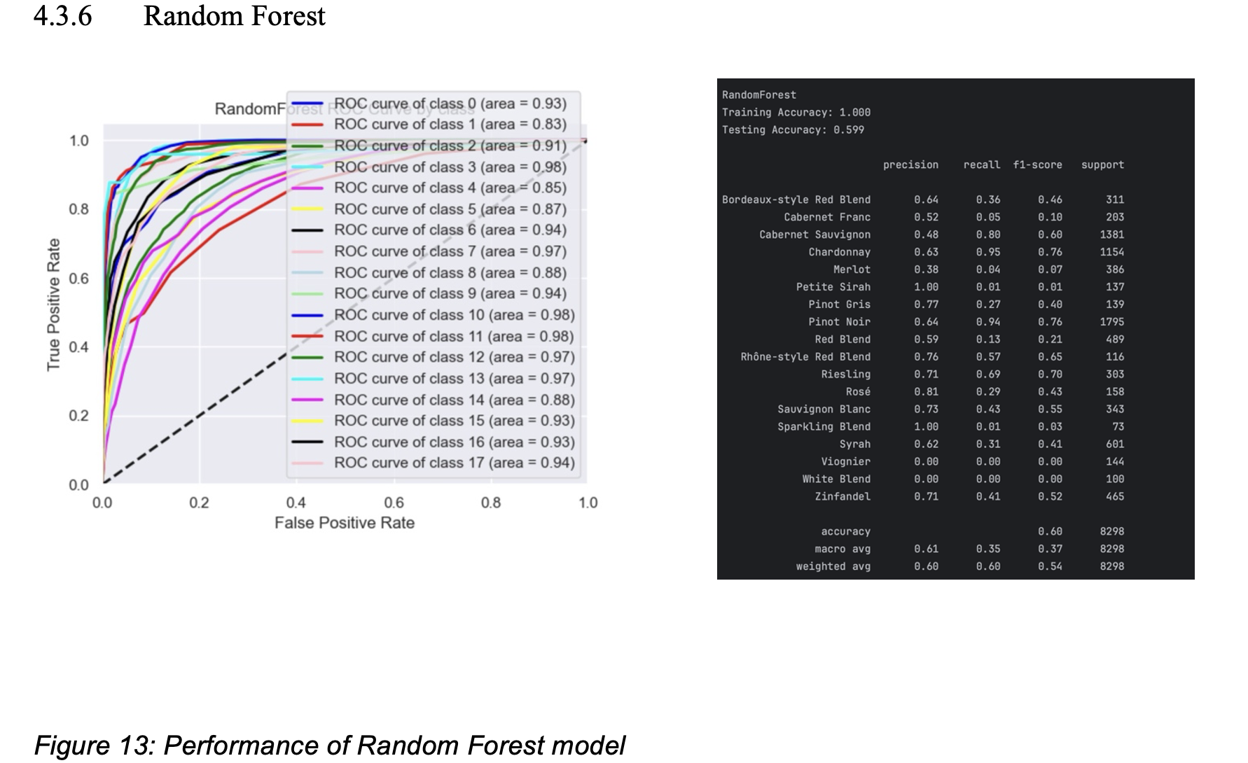
Phase III – Classification Analysis contd…

Slide 17
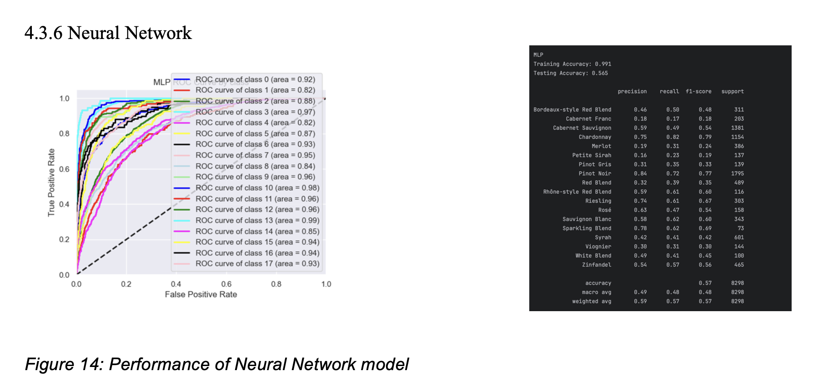
Phase III – Classification Analysis contd…

Slide 18
FINAL MODEL SELECTED
Here we can see the random forest has achieved the highest testing accuracy 60% and has a high AUC. The precision of the model is much higher than any other model. However, there is overfitting as the training accuracy is found to be 100%. We can however remove the overfitting easily by tuning. After hyperparameter tuning it is found to be 75.87% accuracy

Slide 19
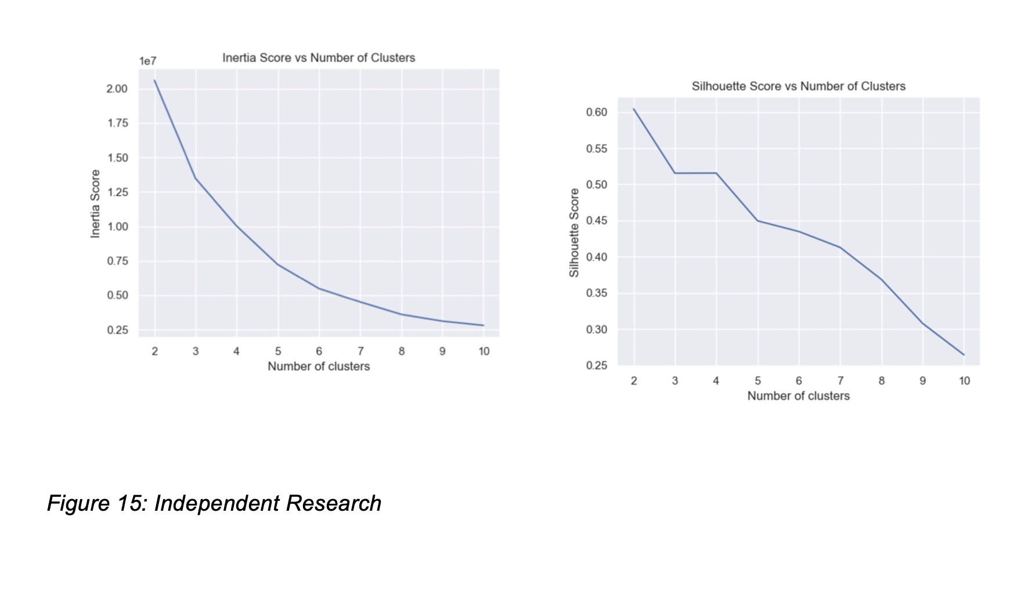
Phase IV – Clustering and Association
Kmean
DBSCAN
Apriori

Slide 20
REFERENCES
https://www.geeksforgeeks.org/detect-and-remove-the-outliers-using-python/
https://www.geeksforgeeks.org/ml-label-encoding-of-datasets-in-python/
https://scikit-learn.org/stable/modules/generated/sklearn.metrics.ConfusionMatrixDispl ay.html
https://towardsdatascience.com/ways-to-detect-and-remove-the-outliers-404d16608db a
https://www.kaggle.com/datasets/zynicide/wine-reviews

Slide 21
THANK YOU

